Slide 1
Quick Blocks
L3A-1

Slide 2
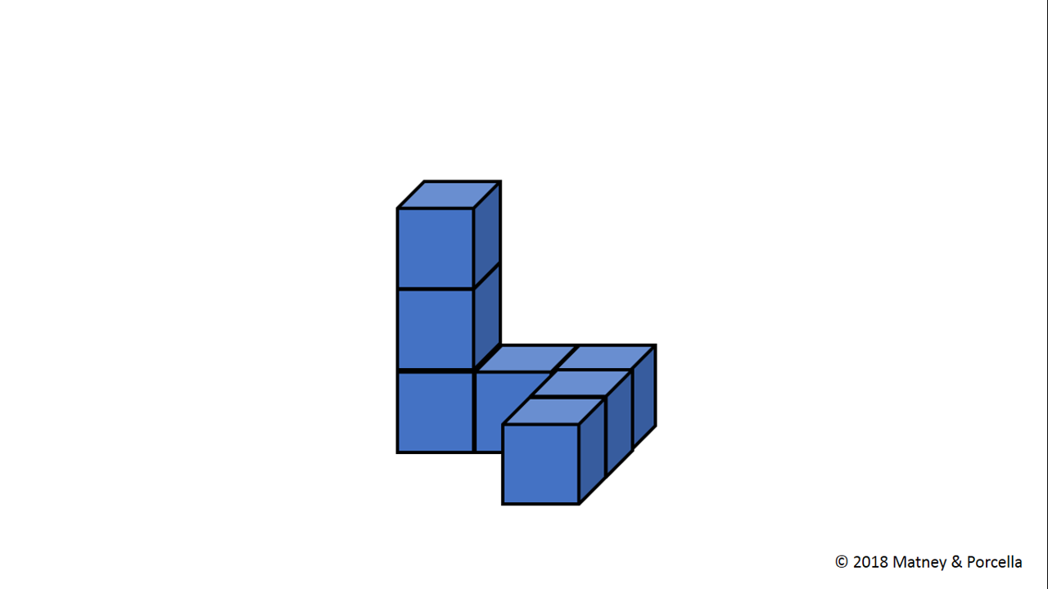

Slide 3
Quick Blocks
L3A-1

Slide 5
Quick Blocks
L3A-2

Slide 6
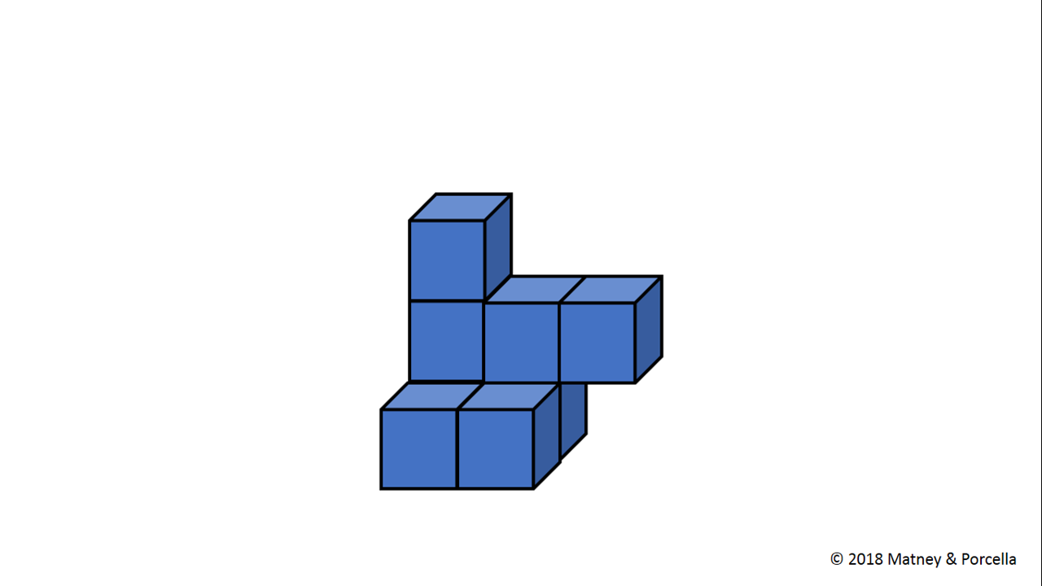

Slide 7
Quick Blocks
L3A-2

Slide 9
Quick Blocks
L3A-3

Slide 10
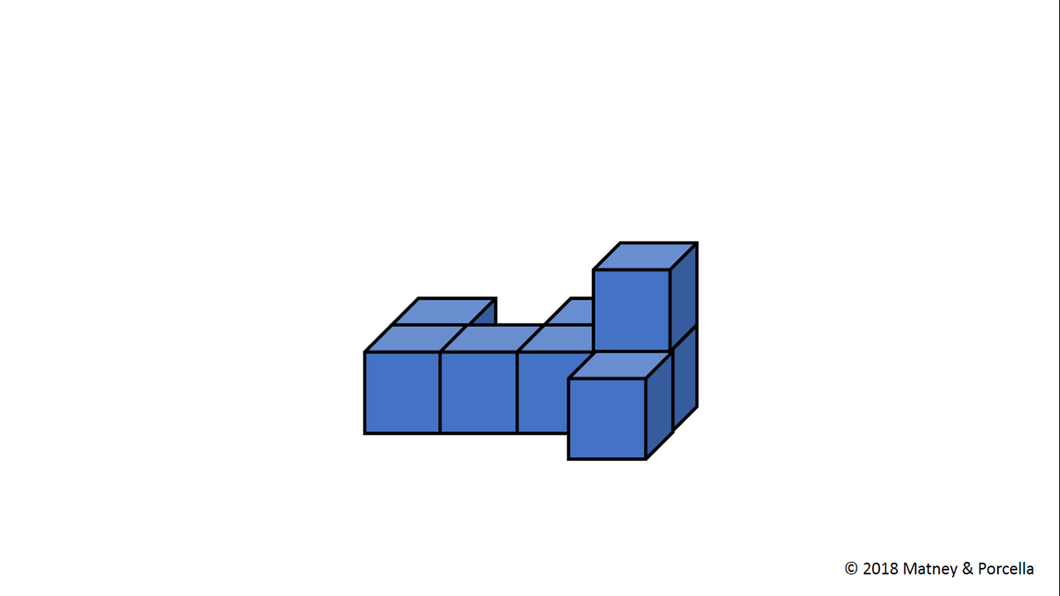

Slide 11
Quick Blocks
L3A-3

Slide 13
Quick Blocks
L3A-4

Slide 14
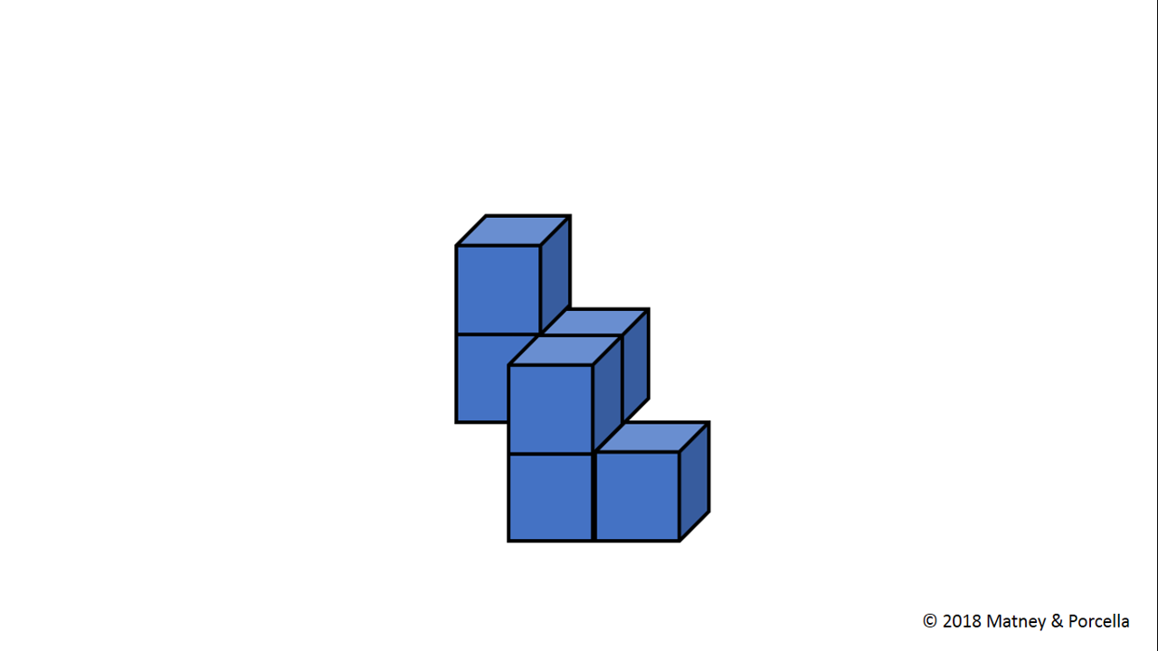

Slide 15
Quick Blocks
L3A-4

Slide 17
Quick Blocks
L3A-5

Slide 18
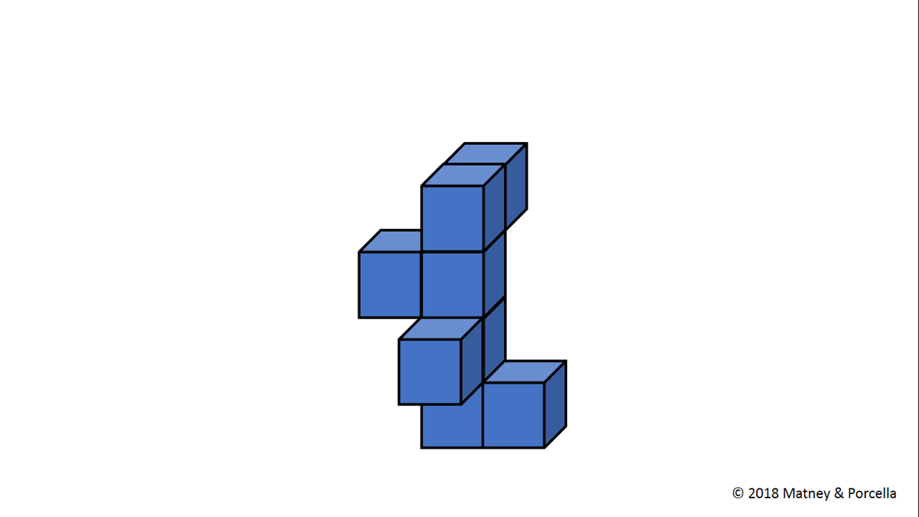

Slide 19
Quick Blocks
L3A-5

Slide 21
Quick Blocks
L3A-6

Slide 22
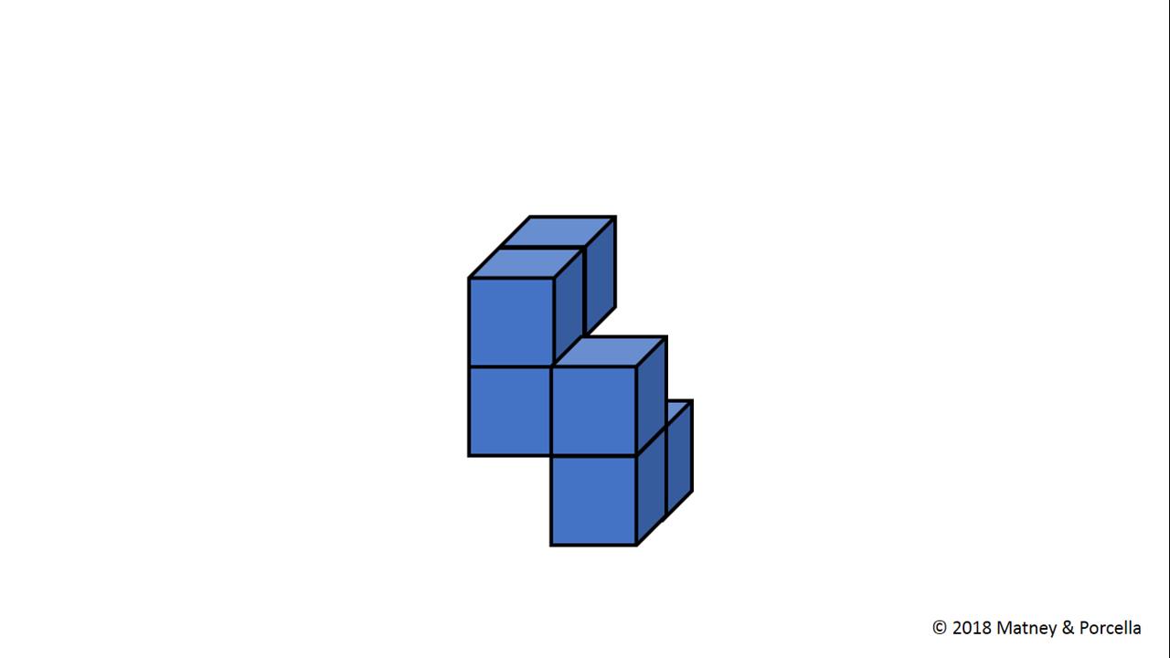

Slide 23
Quick Blocks
L3A-6

Slide 25
Quick Blocks
L3A-7

Slide 26
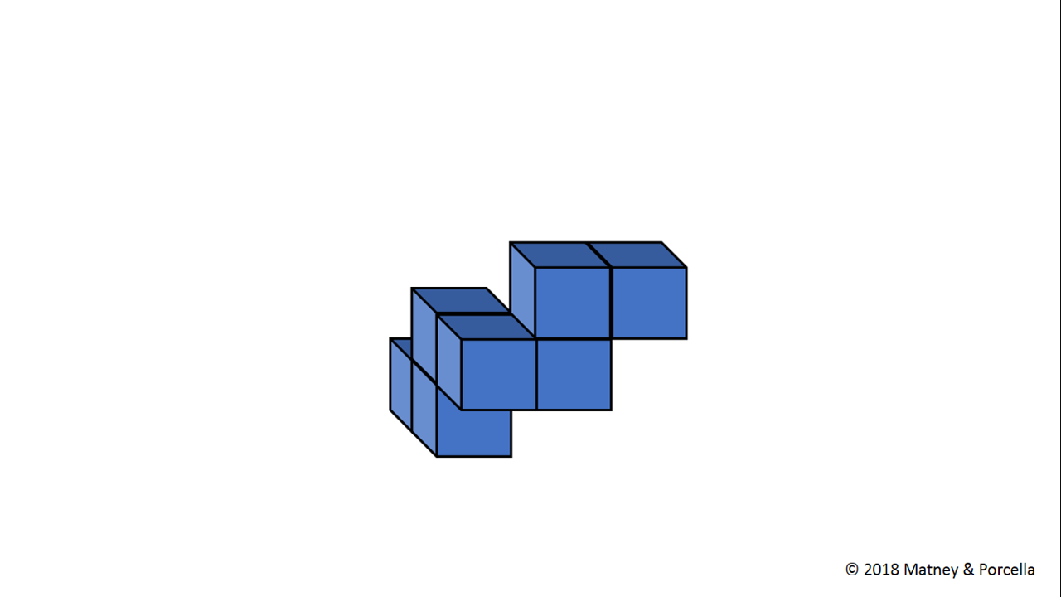

Slide 27
Quick Blocks
L3A-7

Slide 29
Quick Blocks
L3A-8

Slide 30
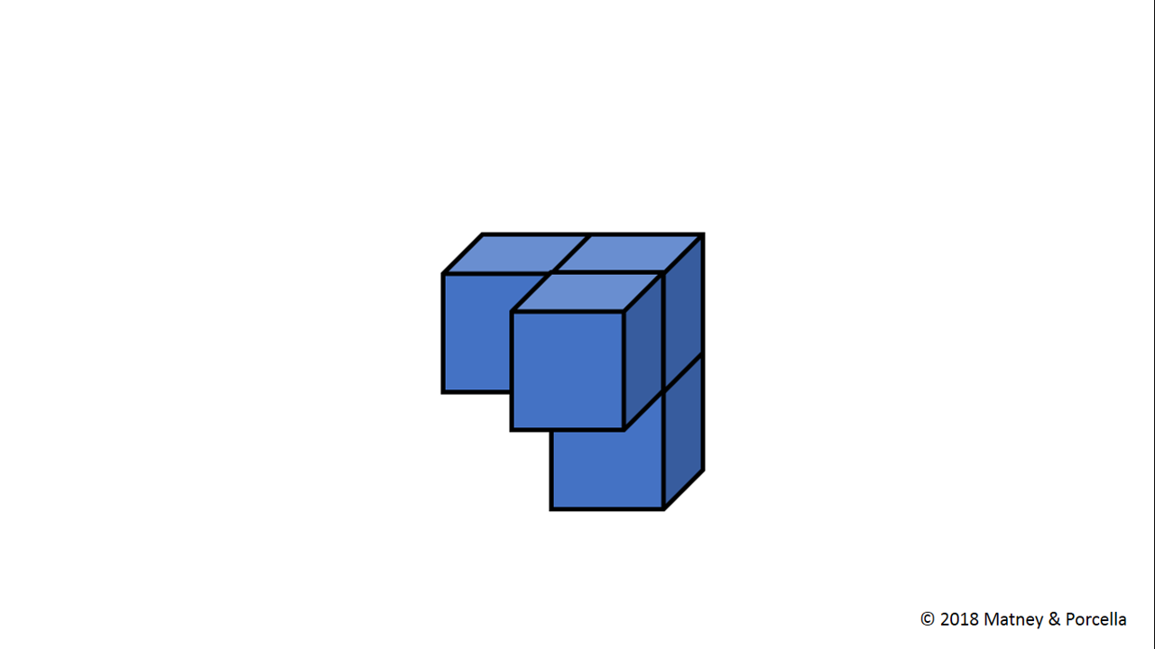

Slide 31
Quick Blocks
L3A-8

Slide 33
Quick Blocks
L3A-9

Slide 34
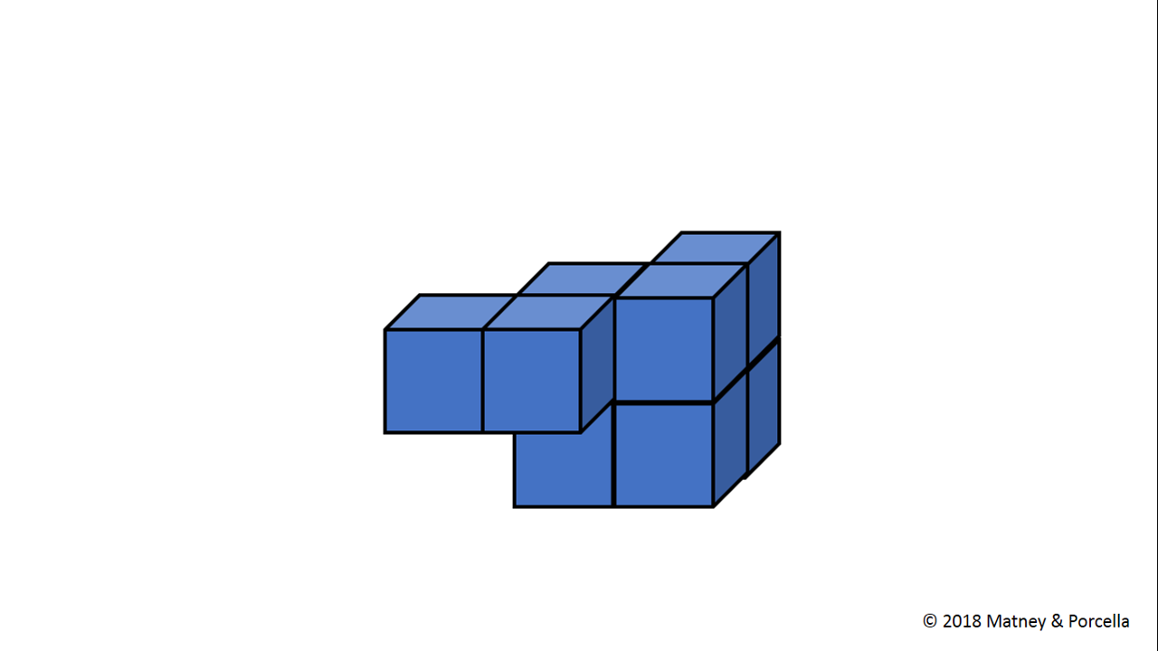

Slide 35
Quick Blocks
L3A-9

Slide 37
Quick Blocks
L3A-10

Slide 38
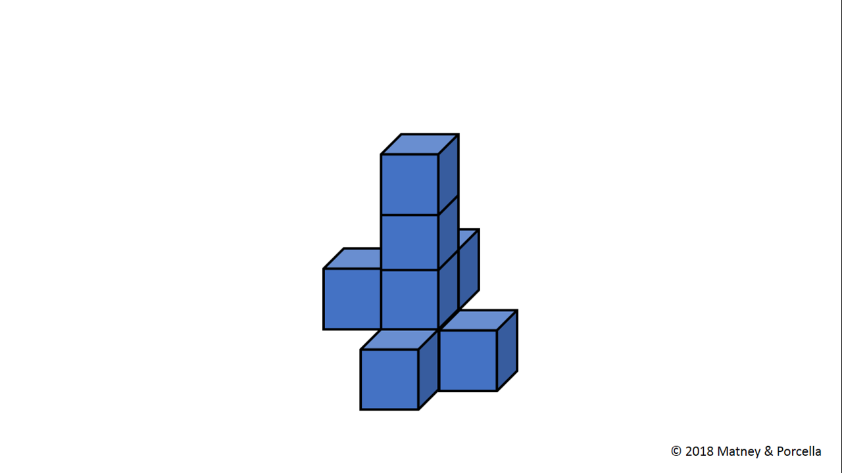

Slide 39
Quick Blocks
L3A-10

Slide 41
Quick Blocks
L3B-1

Slide 42
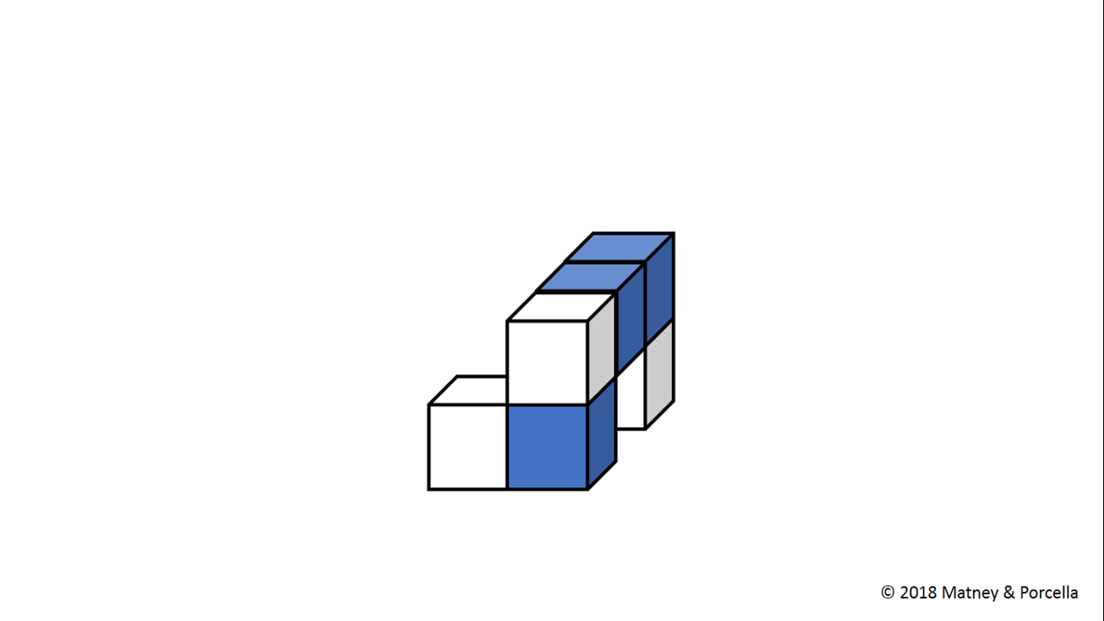

Slide 43
Quick Blocks
L3B-1

Slide 45
Quick Blocks
L3B-2

Slide 46
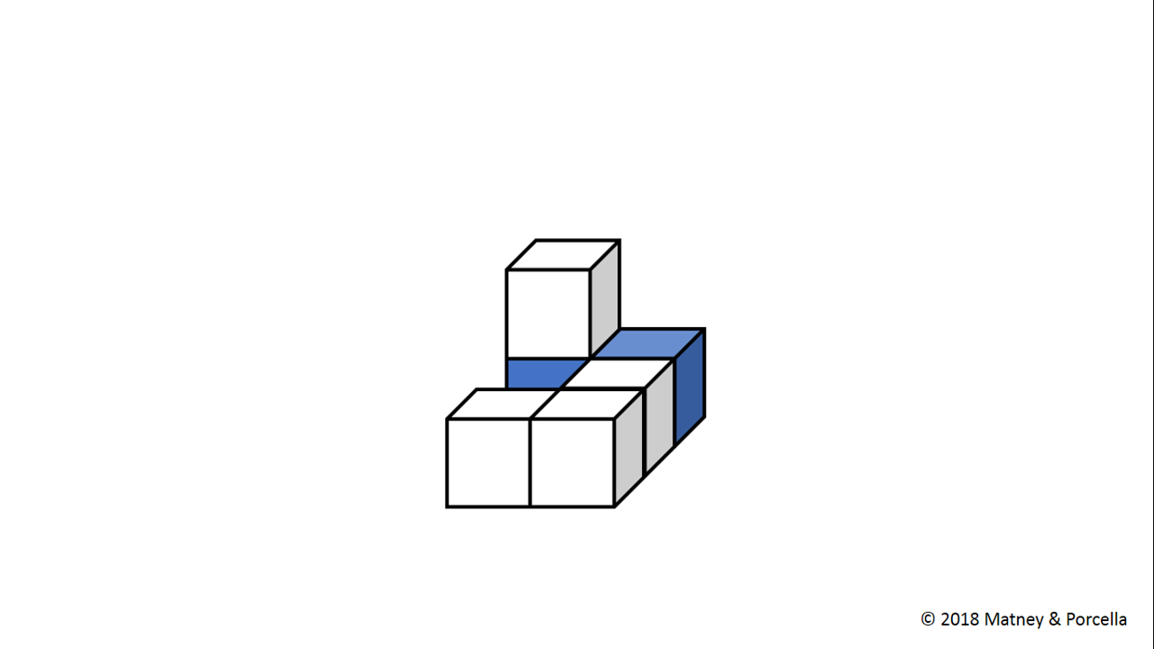

Slide 47
Quick Blocks
L3B-2

Slide 49
Quick Blocks
L3B-3

Slide 50
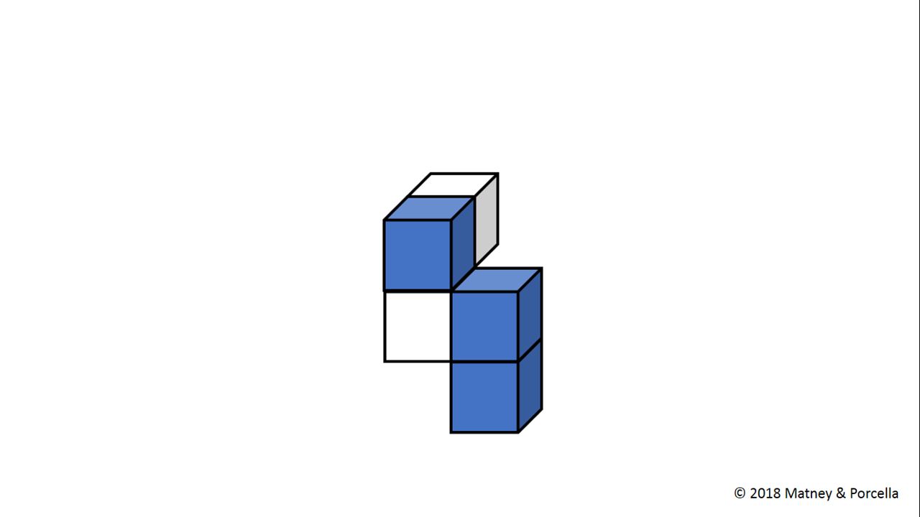

Slide 51
Quick Blocks
L3B-3

Slide 53
Quick Blocks
L3B-4

Slide 54
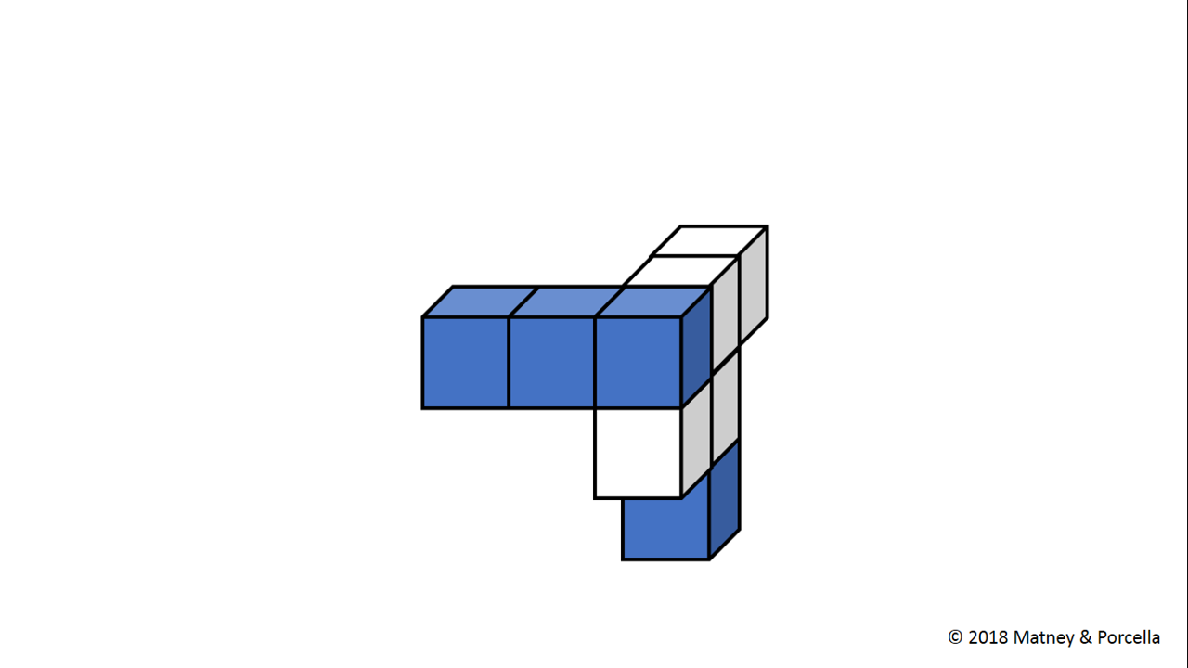

Slide 55
Quick Blocks
L3B-4

Slide 57
Quick Blocks
L3B-5

Slide 58
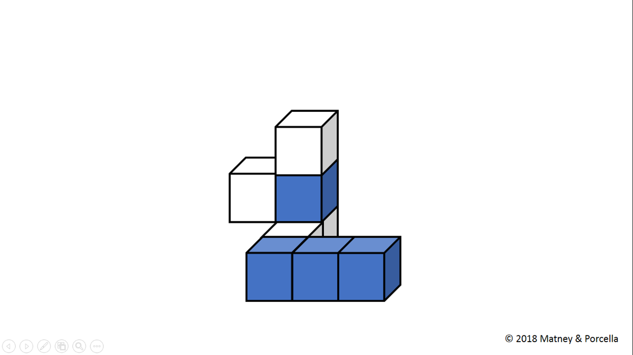

Slide 59
Quick Blocks
L3B-5

Slide 61
Quick Blocks
L3B-6

Slide 62
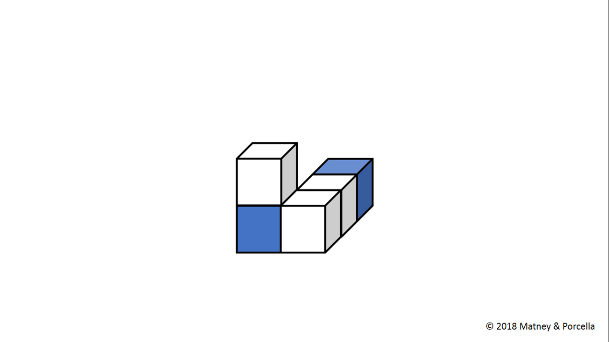

Slide 63
Quick Blocks
L3B-6

Slide 65
Quick Blocks
L3B-7

Slide 66
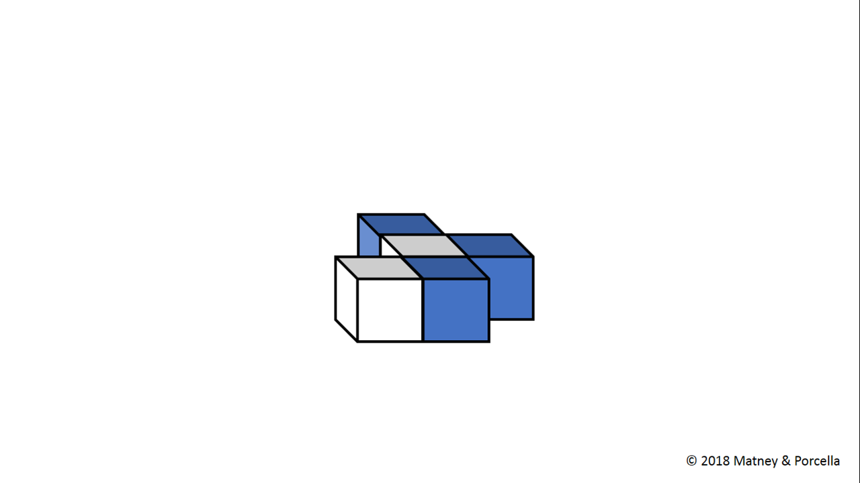

Slide 67
Quick Blocks
L3B-7

Slide 69
Quick Blocks
L3B-8

Slide 70
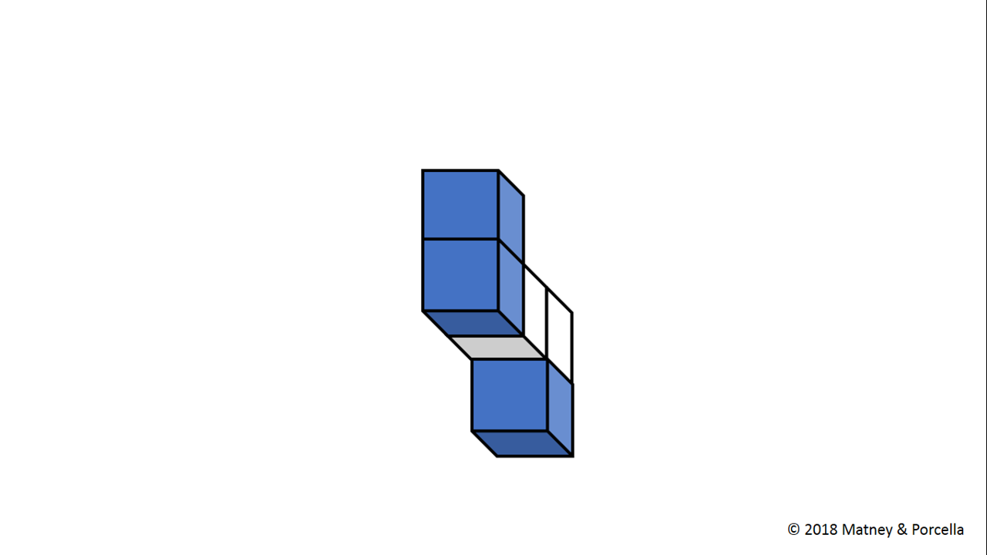

Slide 71
Quick Blocks
L3B-8

Slide 73
Quick Blocks
L3B-9

Slide 74
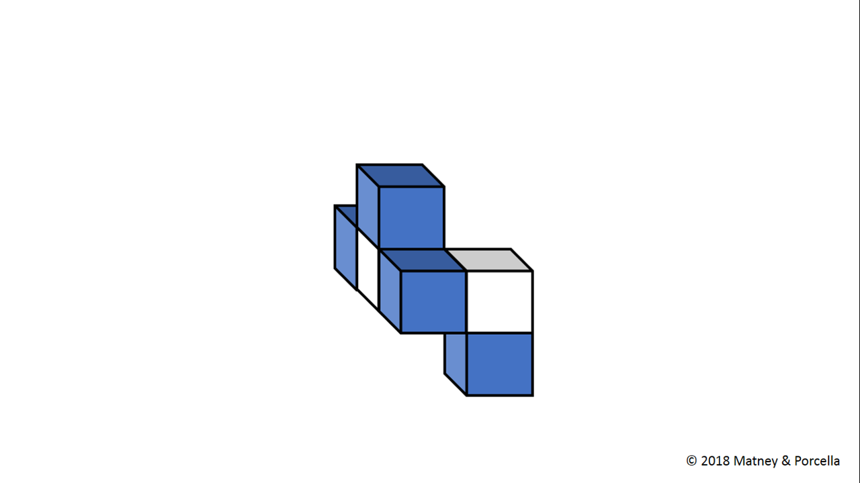

Slide 75
Quick Blocks
L3B-9

Slide 77
Quick Blocks
L3B-10

Slide 78
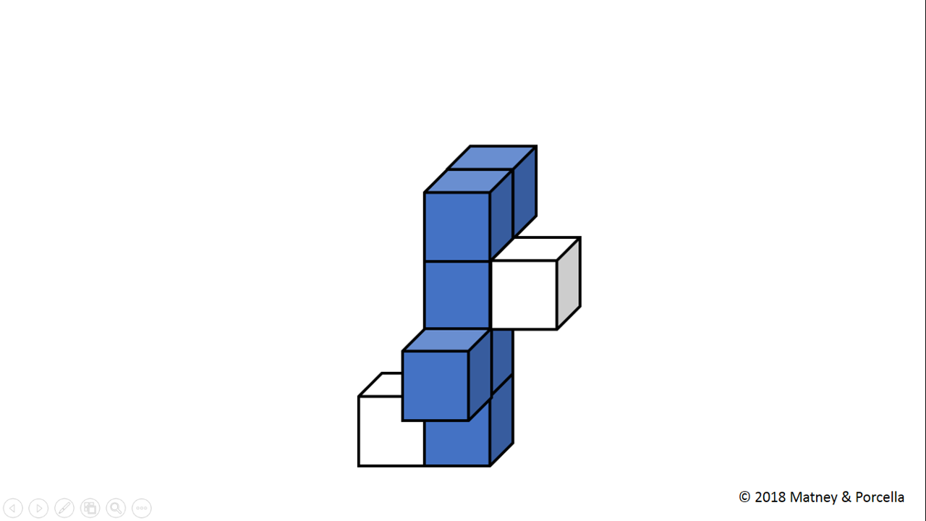

Slide 79
Quick Blocks
L3B-10

Slide 81
Quick Blocks
L3C-1

Slide 82
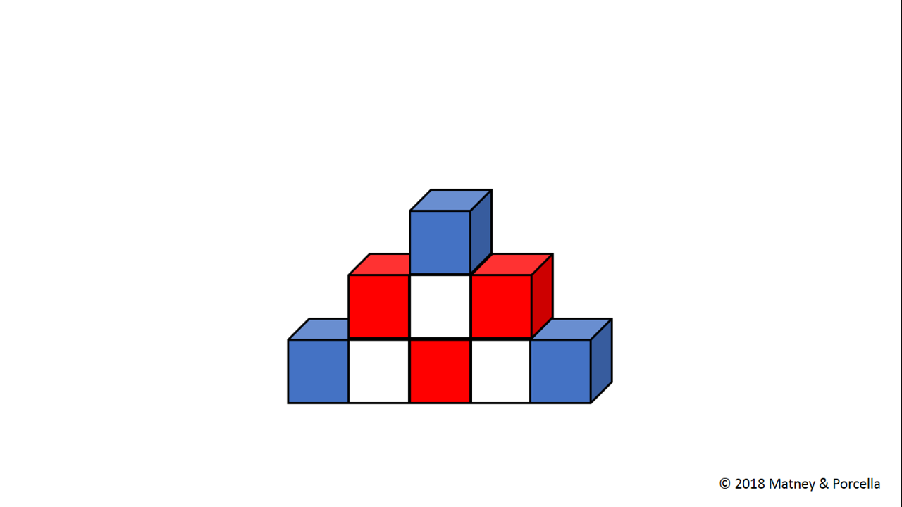

Slide 83
Quick Blocks
L3C-1

Slide 85
Quick Blocks
L3C-2

Slide 86
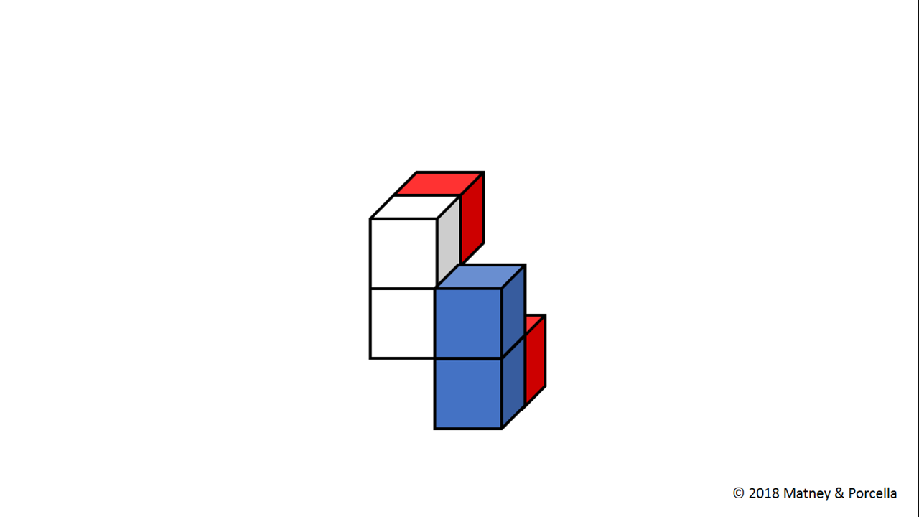

Slide 87
Quick Blocks
L3C-2

Slide 89
Quick Blocks
L3C-3

Slide 90
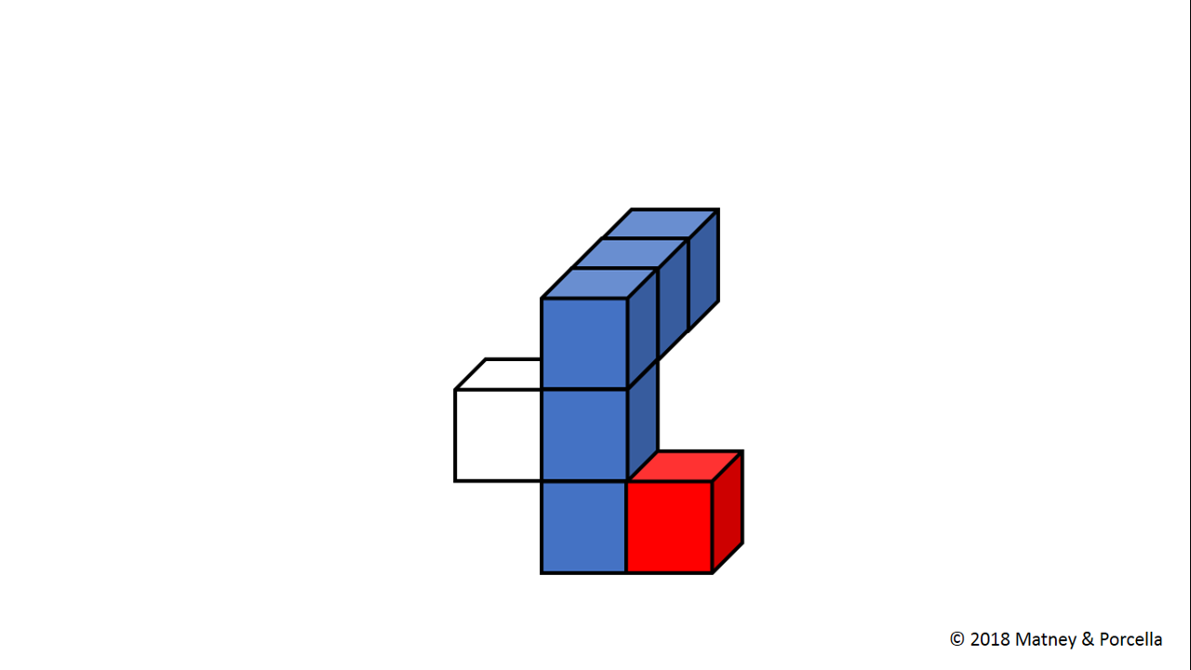

Slide 91
Quick Blocks
L3C-3

Slide 93
Quick Blocks
L3C-4

Slide 94
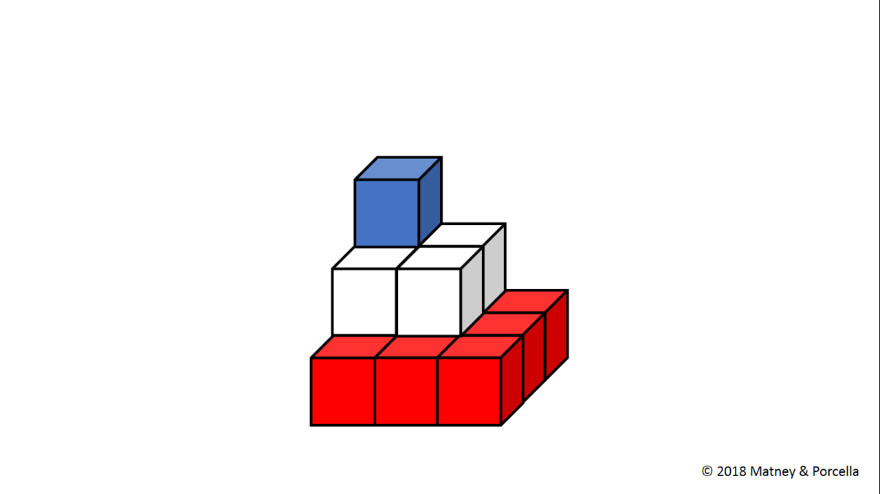

Slide 95
Quick Blocks
L3C-4

Slide 97
Quick Blocks
L3C-5

Slide 98
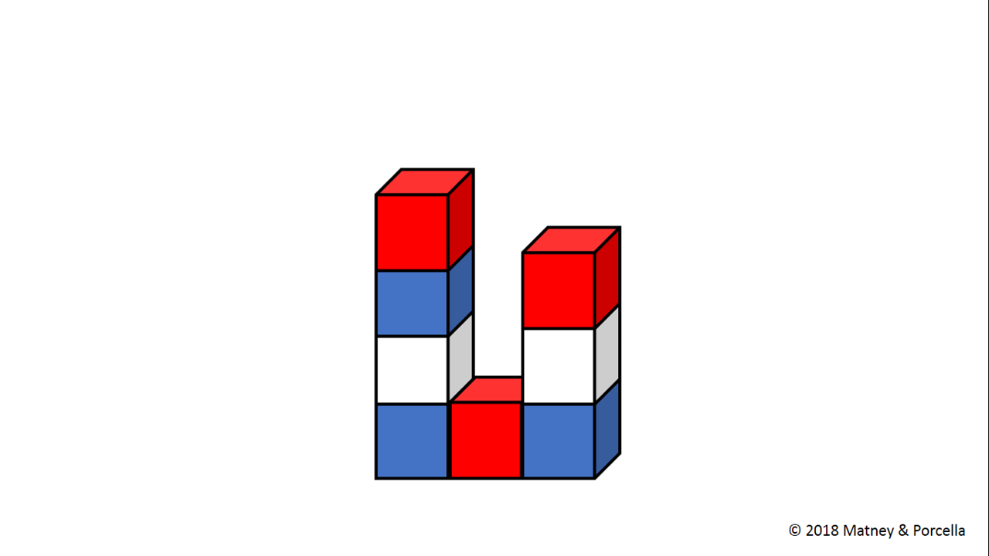

Slide 99
Quick Blocks
L3C-5

Slide 101
Quick Blocks
L3C-6

Slide 102
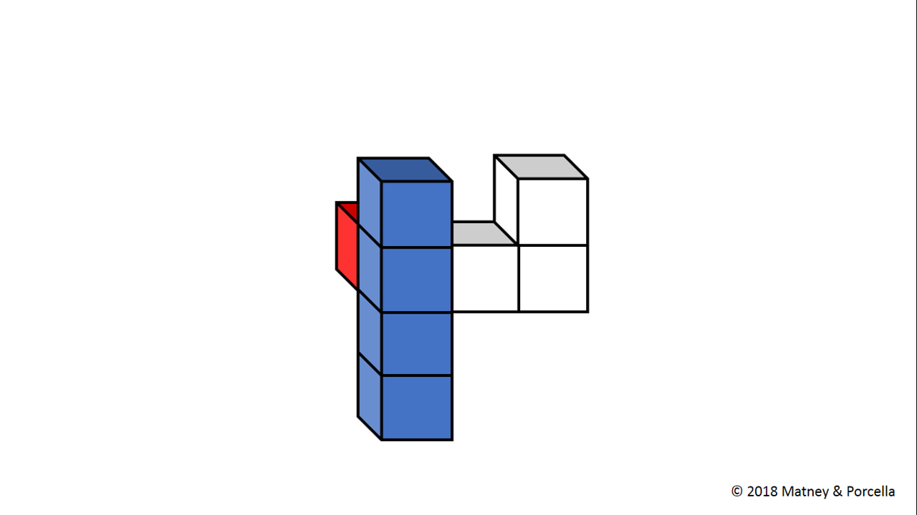

Slide 103
Quick Blocks
L3C-6

Slide 105
Quick Blocks
L3C-7

Slide 106
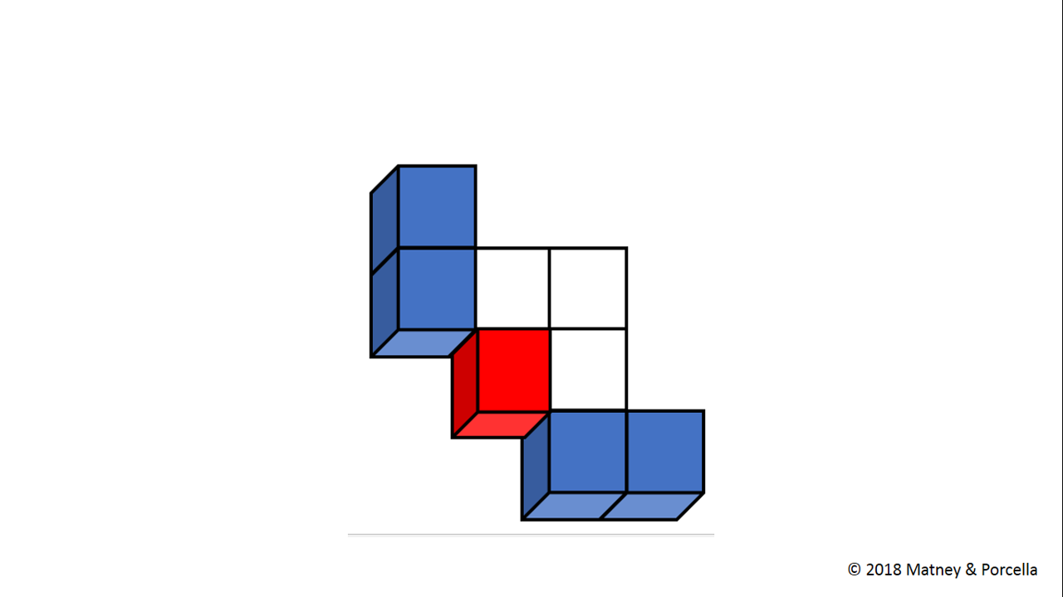

Slide 107
Quick Blocks
L3C-7

Slide 109
Quick Blocks
L3C-8

Slide 110
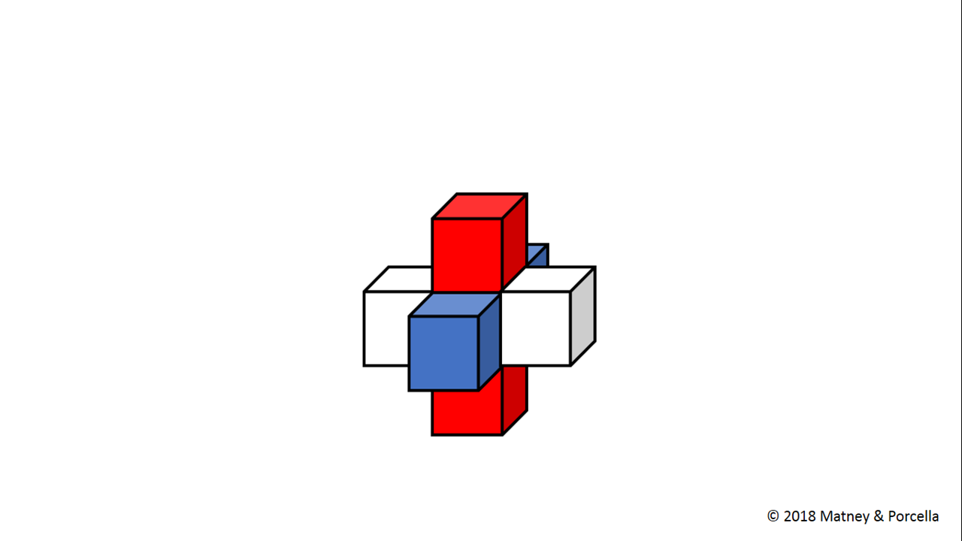

Slide 111
Quick Blocks
L3C-8

Slide 113
Quick Blocks
L3C-9

Slide 114
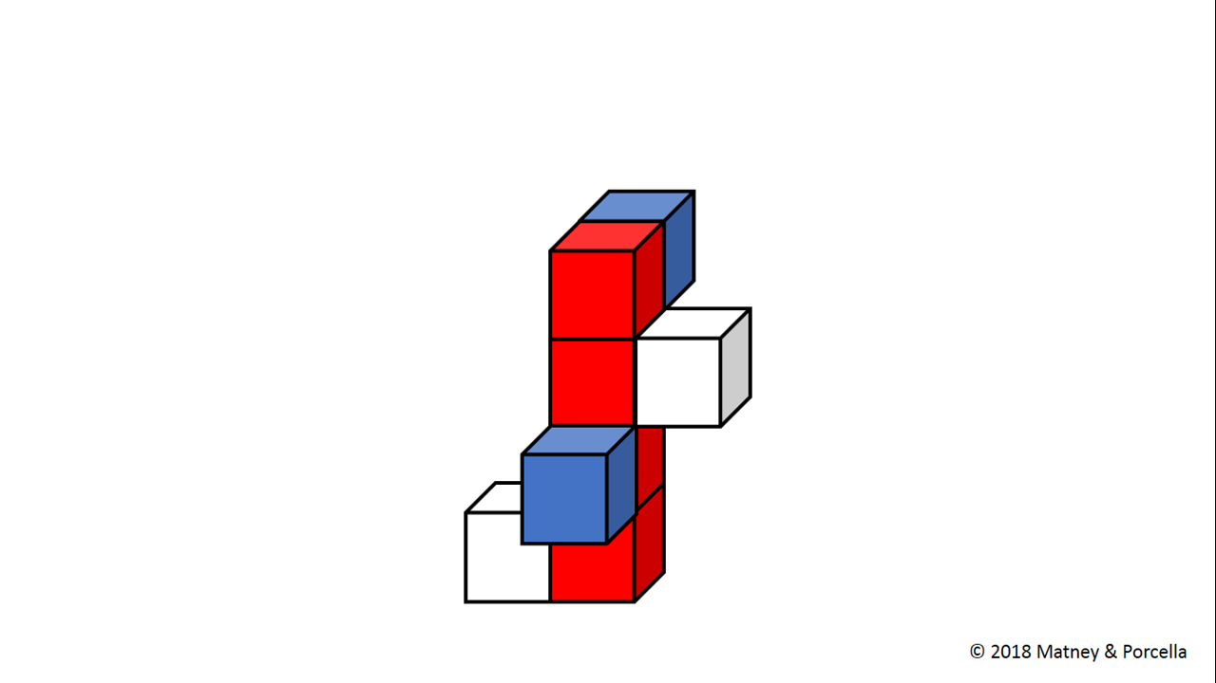

Slide 115
Quick Blocks
L3C-9

Slide 117
Quick Blocks
L3C-10

Slide 118
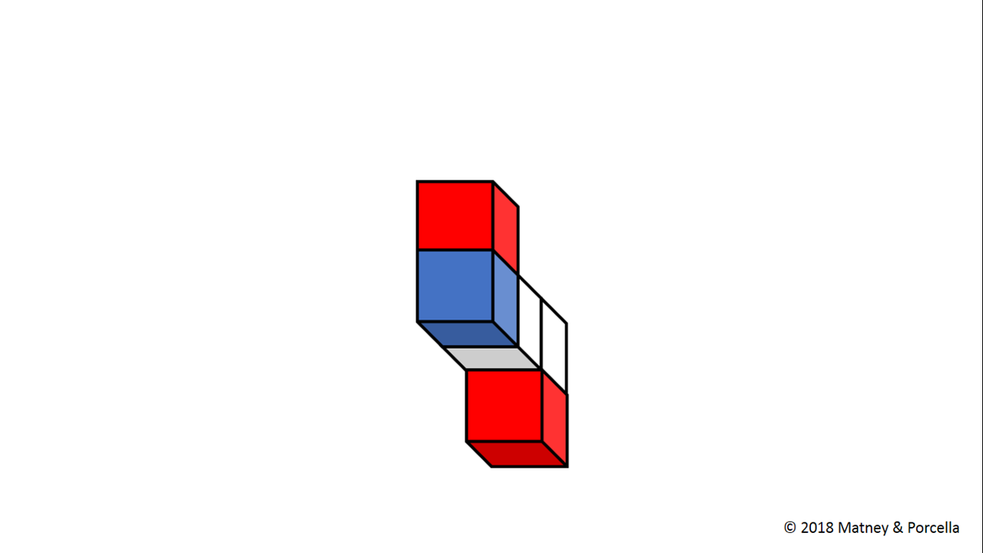

Slide 119
Quick Blocks
L3C-10

